Slide 1
Final Project
Journalism For The Web
10 Photos from Warhawk SOAR Orientation Day.
Peyton Walz

Slide 2
I am a member of Hawk Squad which is part of FYE (first year experience) and we are the people who lead the SOAR orientation days.
I took 10 pictures from my last day working as a Hawk Squad leader.

Slide 3
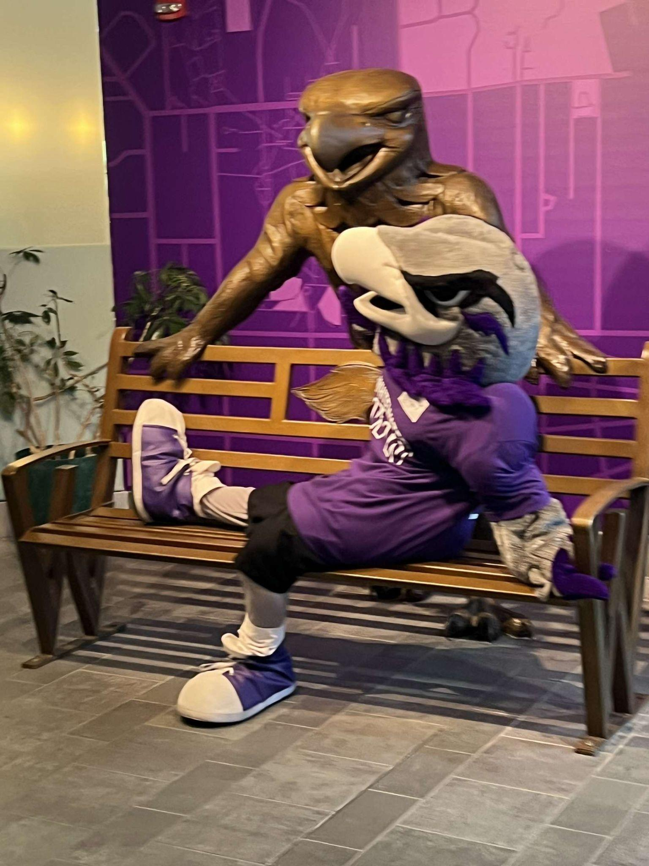
Photo 1
Here is a medium shot of Willie our school mascot being silly right before the SOAR day is about to begin
05
CLOSING
Questions
Thank You

Slide 4
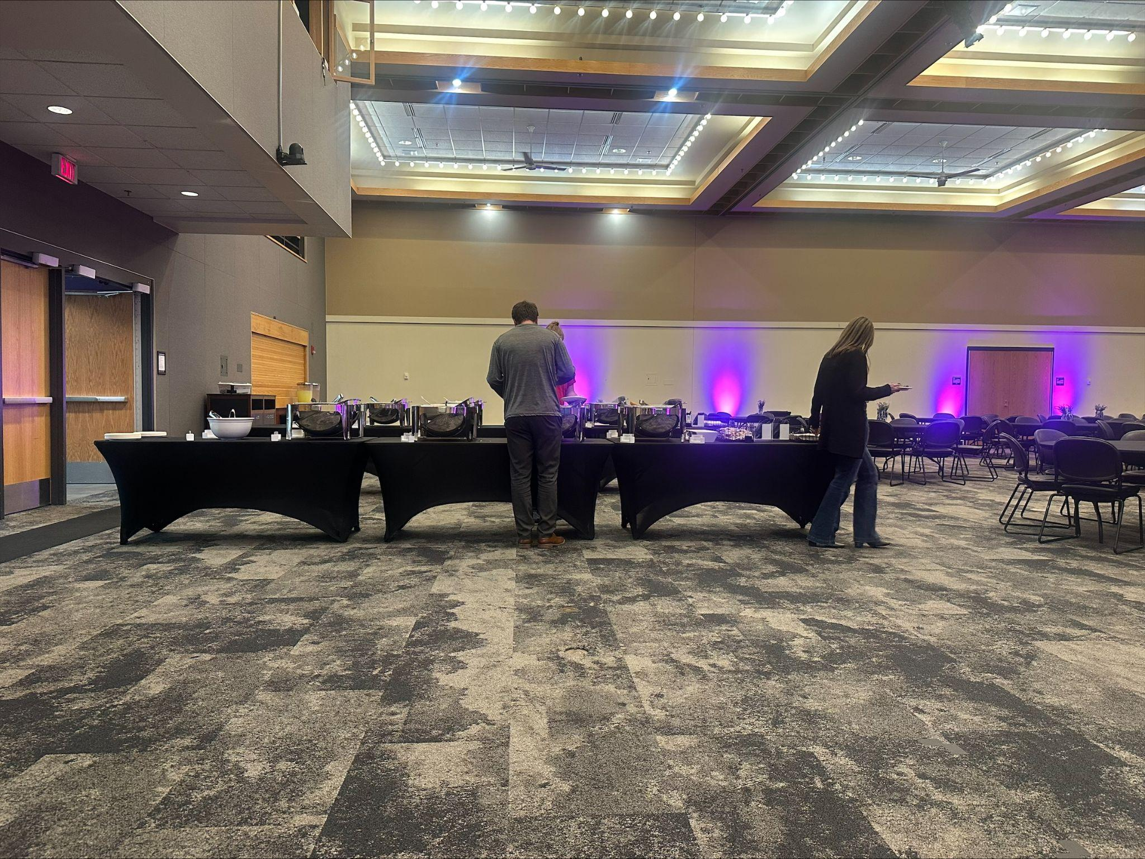
Photo 2
Here is a wide shot of people getting lunch.

Slide 5
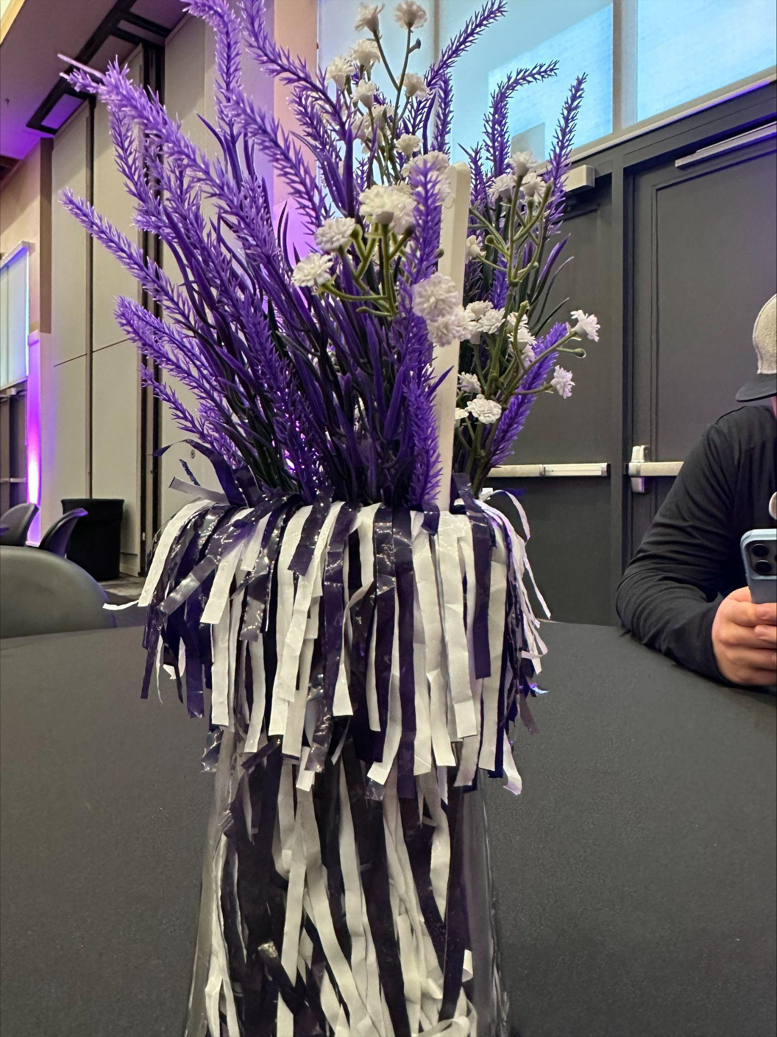
Photo 3
Here is a close-up shot of the table decorations.
80
70
60
50
40
30
20
10
BAR GRAPH INFO 1
BAR GRAPH INFO 1
BAR GRAPH INFO 1
BAR GRAPH INFO 1

Slide 6
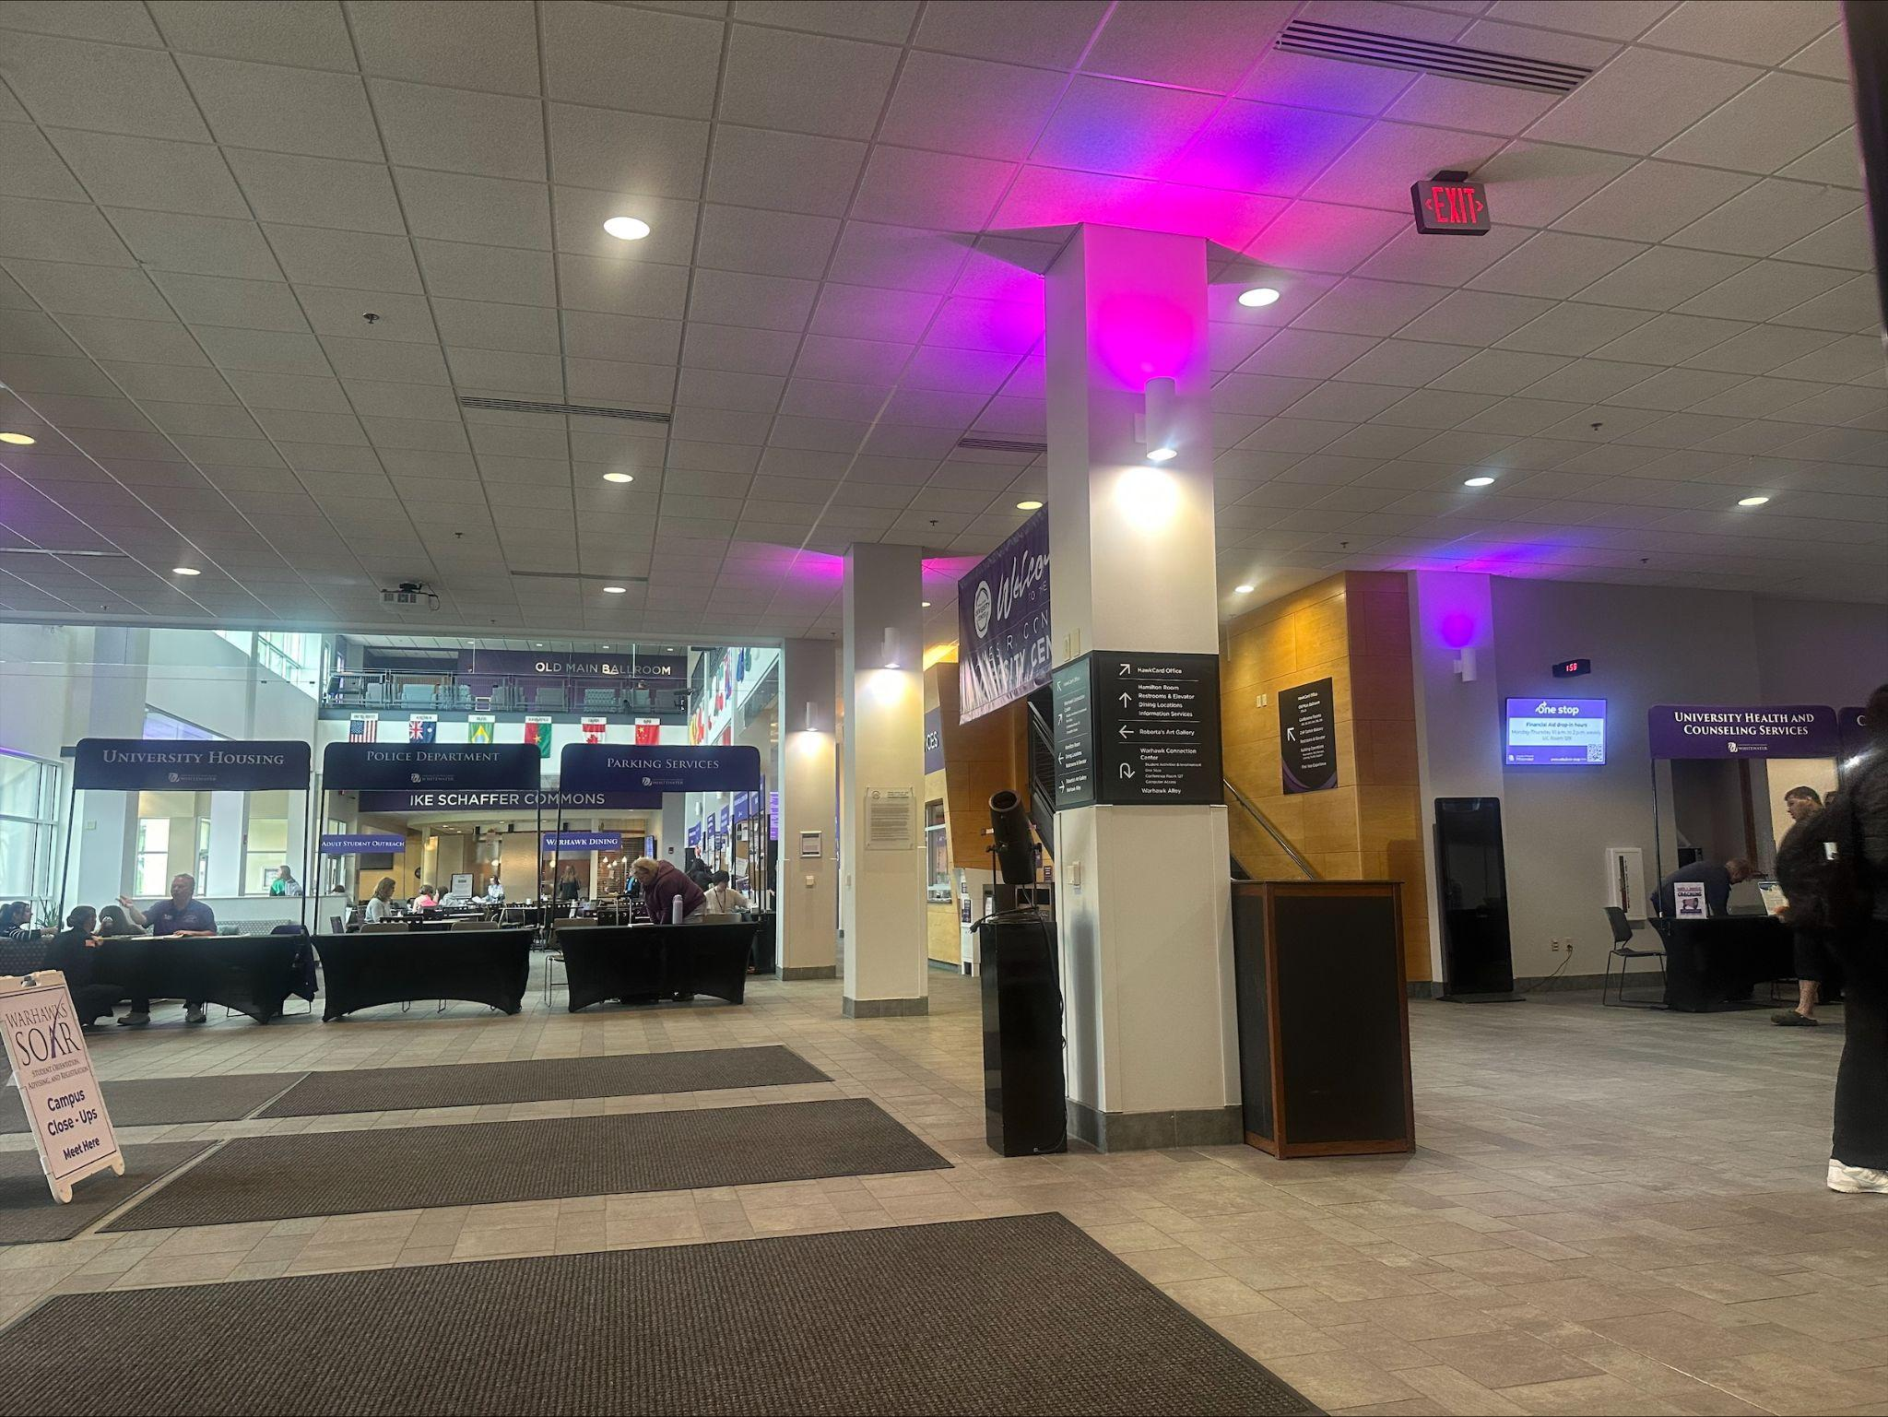
Photo 4
Here is an example of an extreme wide shot of the UC set up for the resource fair.

Slide 7
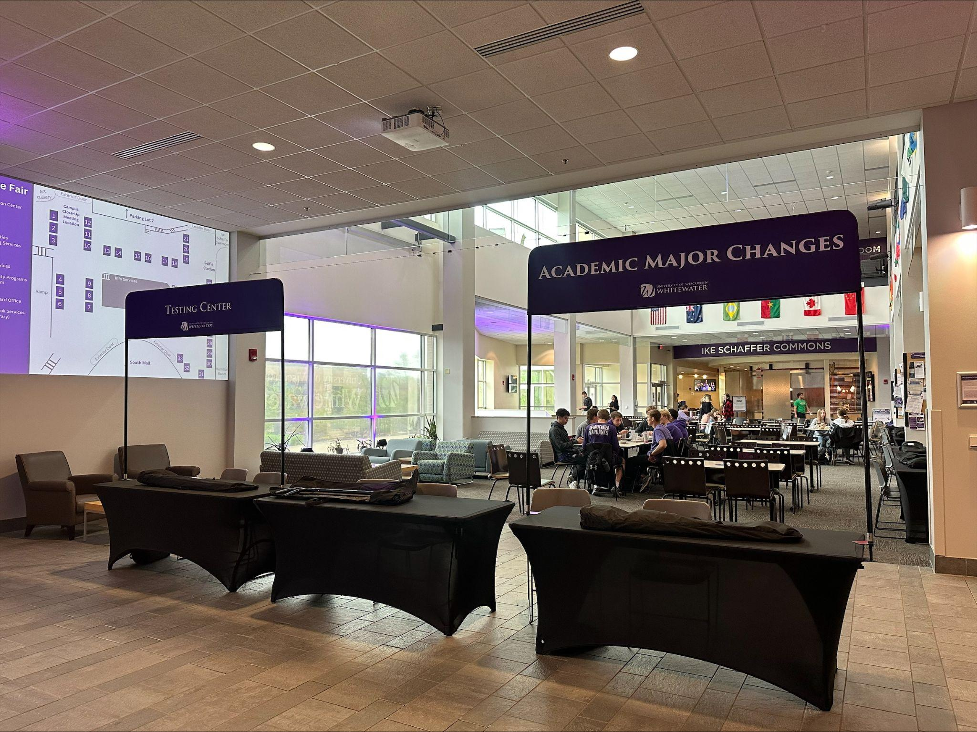
Photo 5
Here is a wide shot of two of the resource banners set up and one that still needs to be put up.

Slide 8
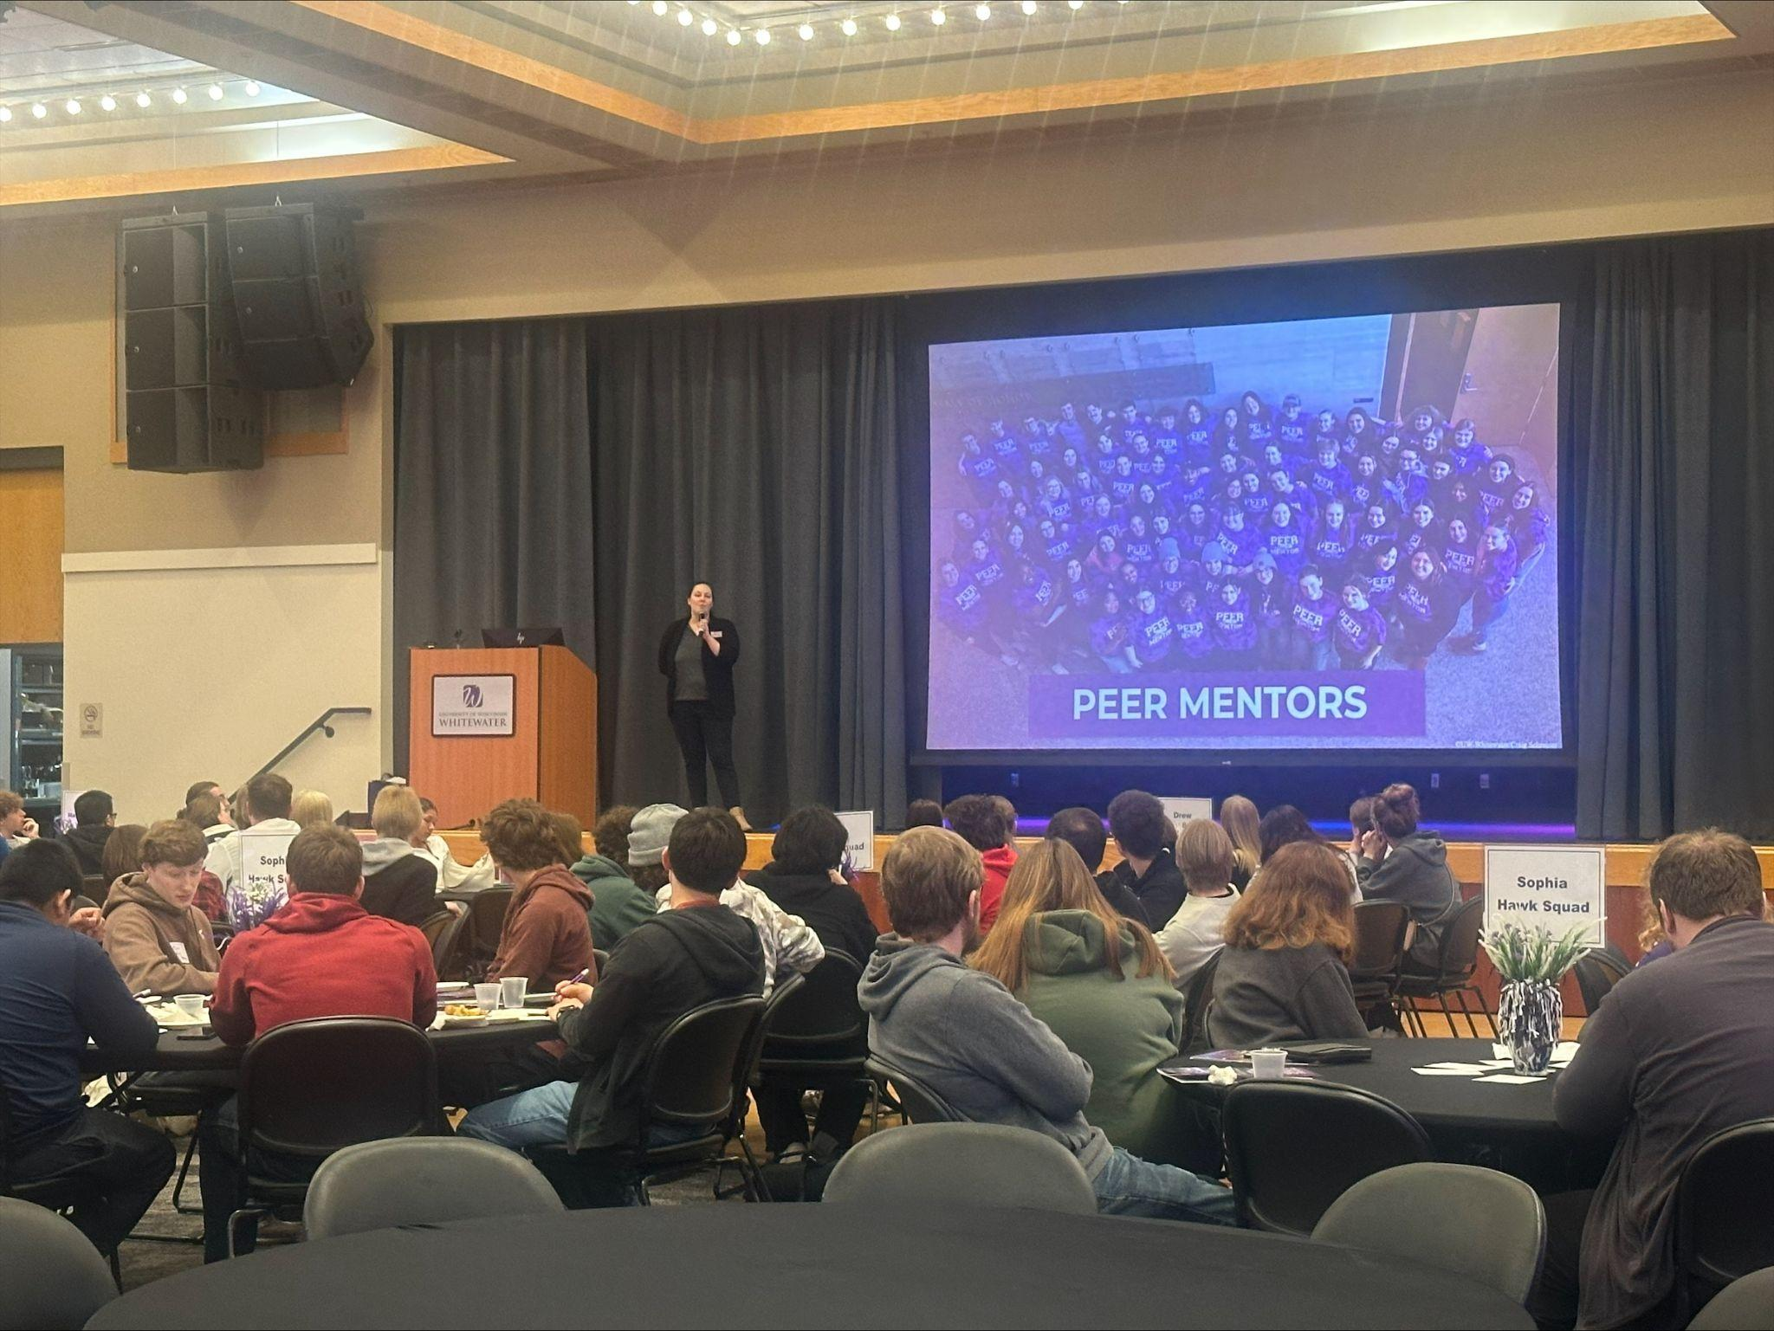
Photo 6
Here is a photo from a presentation going on about another resource that FYE offers

Slide 9
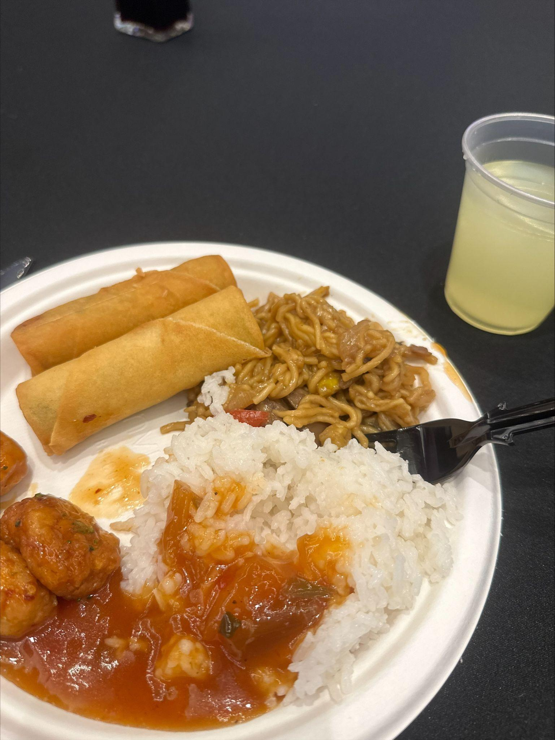
Photo 7
Here is a photo of the lunch that was catered in for the event.

Slide 10
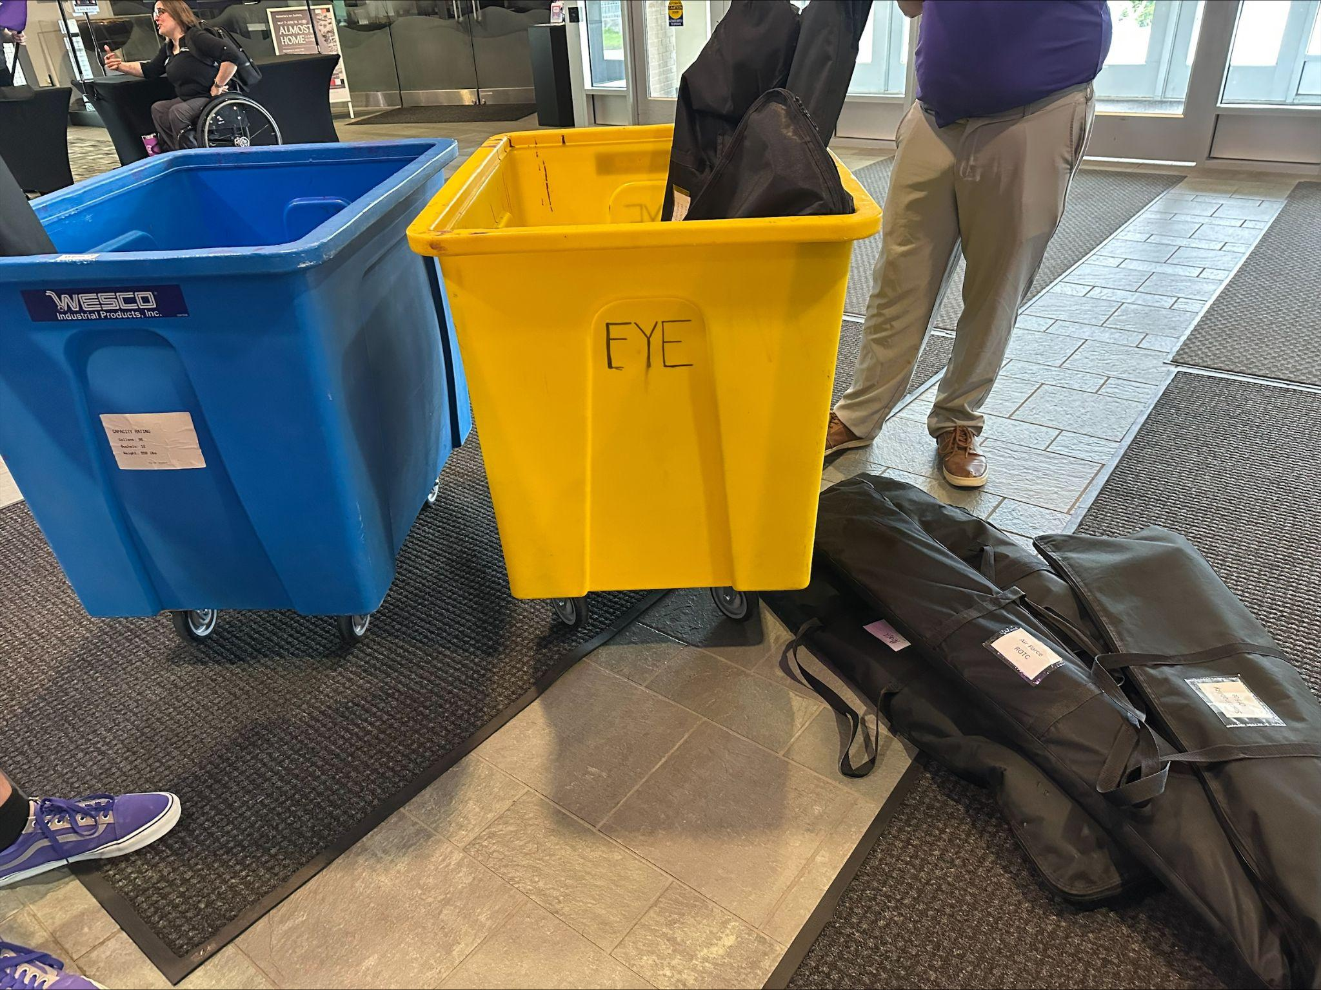
Photo 8
Here are the bins that we keep the table banners in when we set up the resource fair.

Slide 11
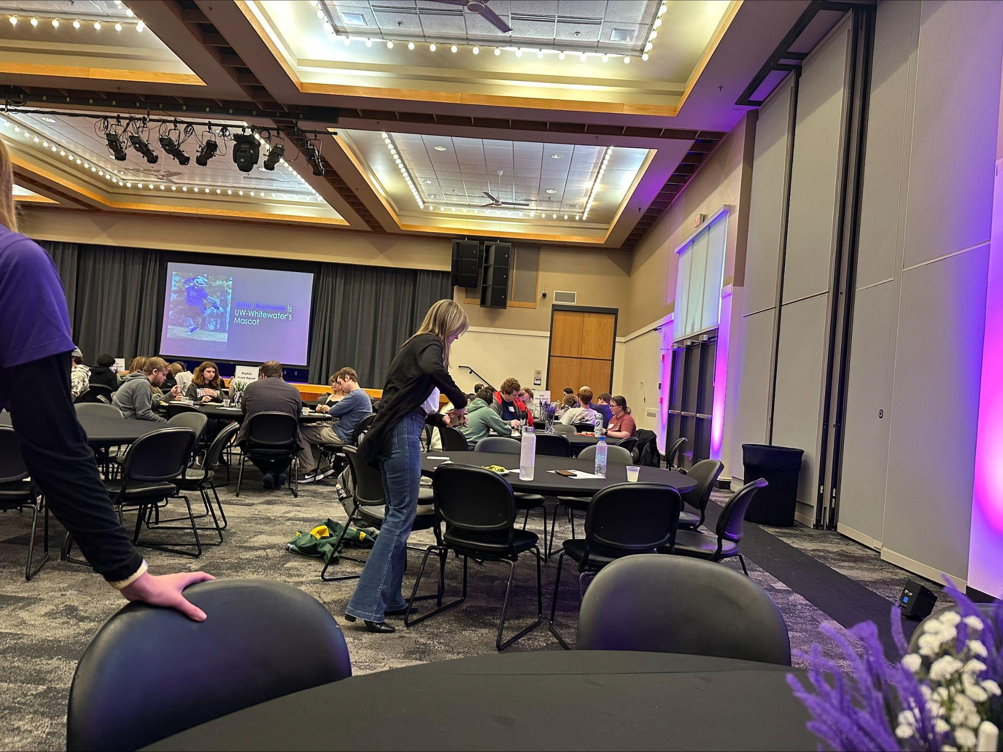
Photo 9
Here is another photo from the main presentation that all the students have to listen to

Slide 12
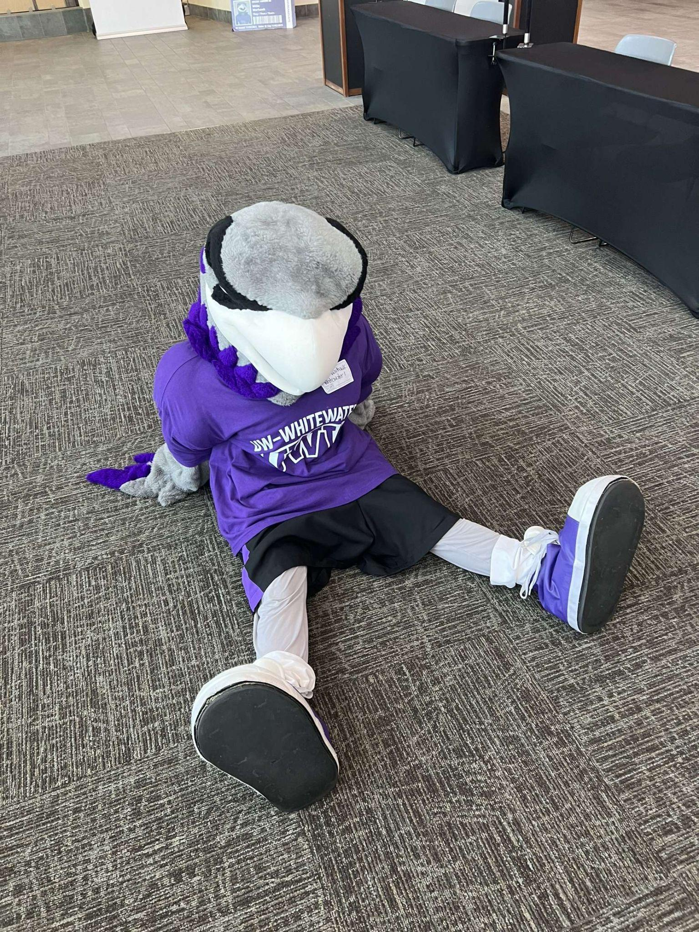
Photo 10
Here is Willie so tired after a long day at SOAR.

