Slide 1
Winter driving advisory
By: Ryan Hoke

Slide 2
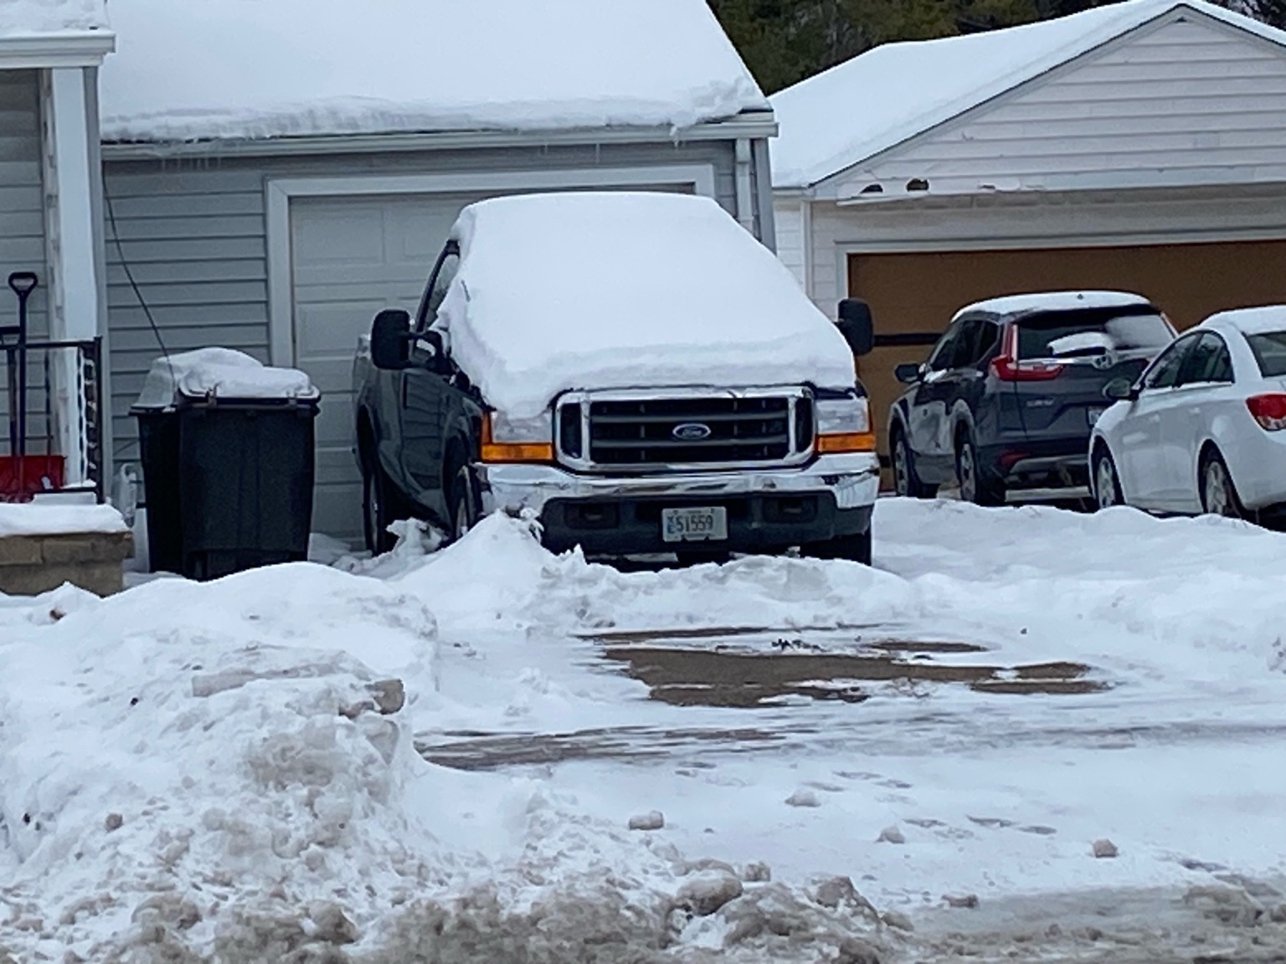
Heavy snowfall buries vehicles overnight in residential neighborhoods.

Slide 3
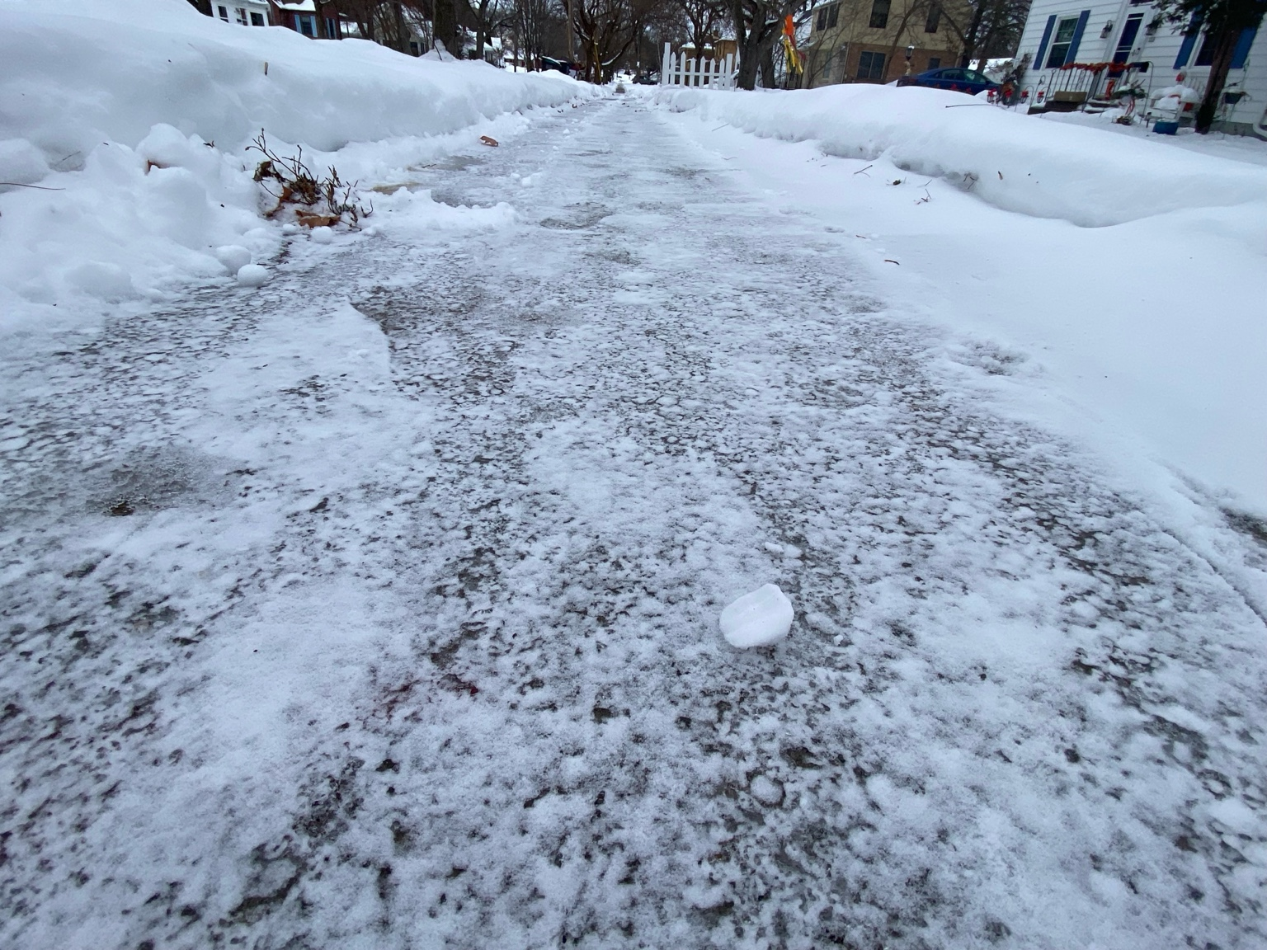
Packed ice creates slipping hazards for pedestrians and drivers.

Slide 4
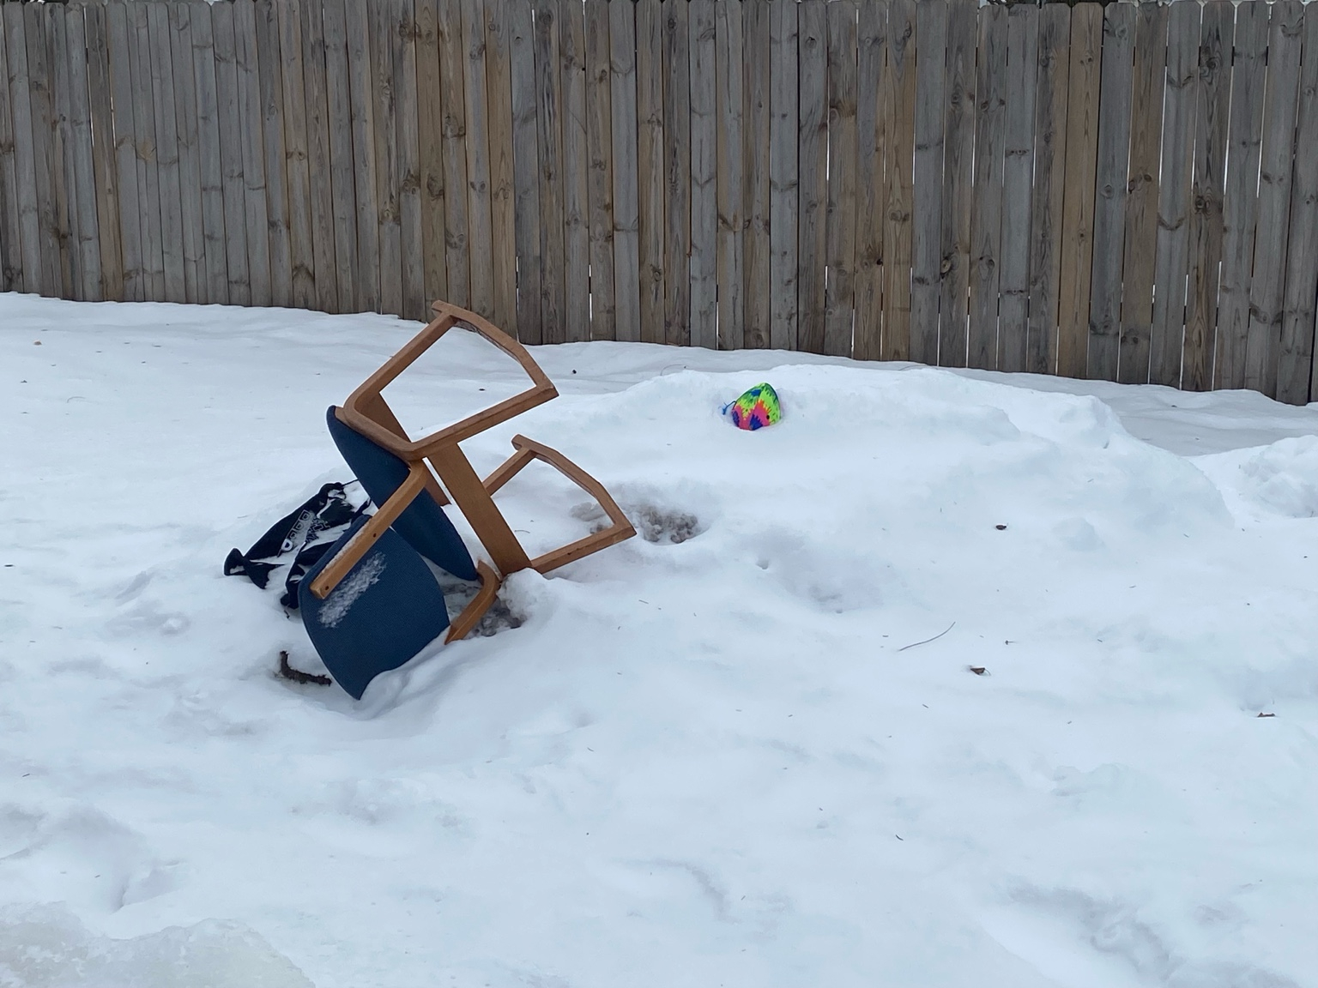
Winter storms disrupt everyday outdoor spaces.

Slide 5
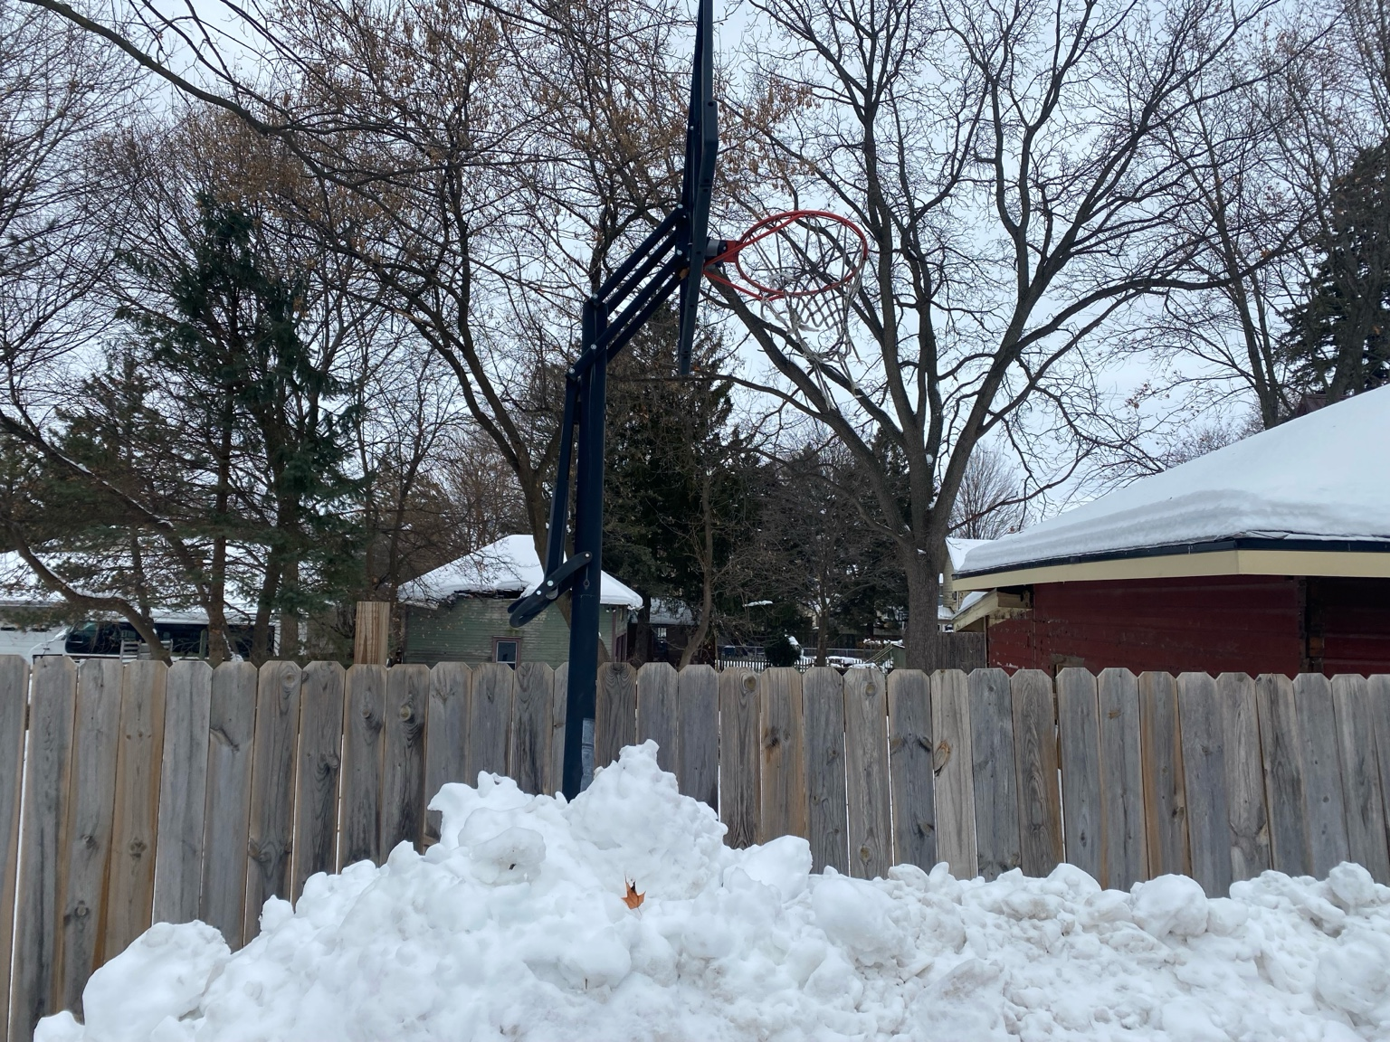
Snowbanks grow as storms continue throughout the season.

Slide 6
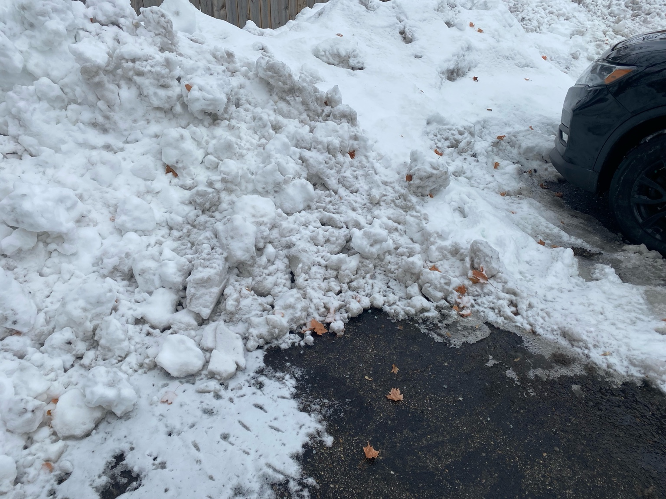
Plowed snow piles create obstacles near parked cars.

Slide 7
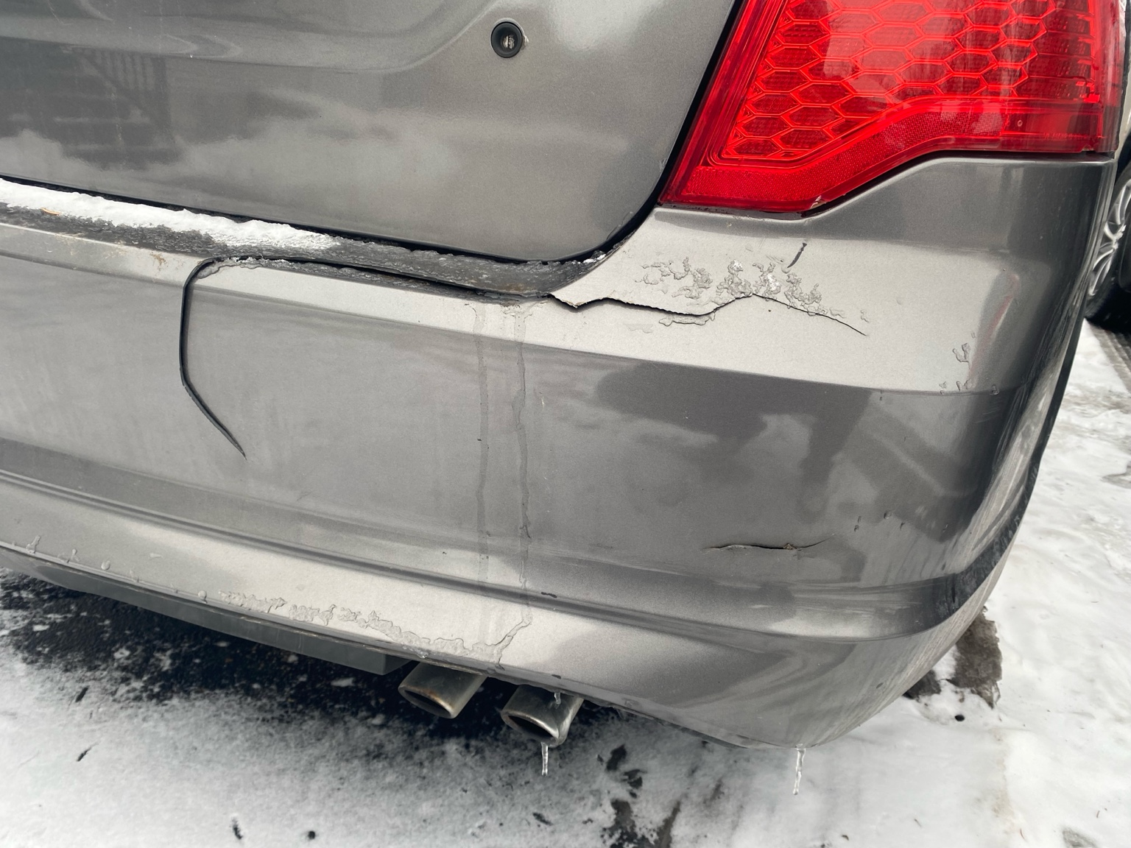
Minor collisions lead to costly vehicle repairs.

Slide 8
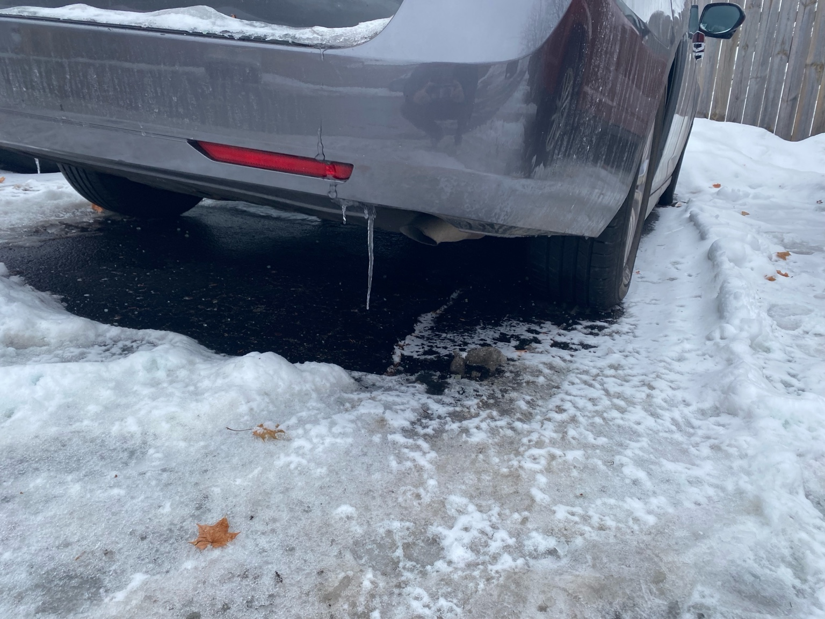
Melting snow freezes beneath parked vehicles overnight.

Slide 9
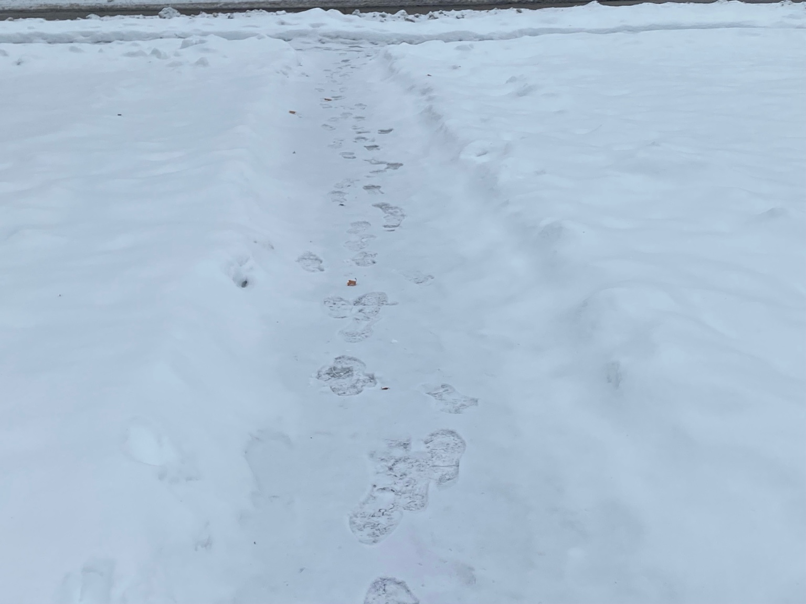
Students navigate snowy paths daily during winter months.

Slide 10
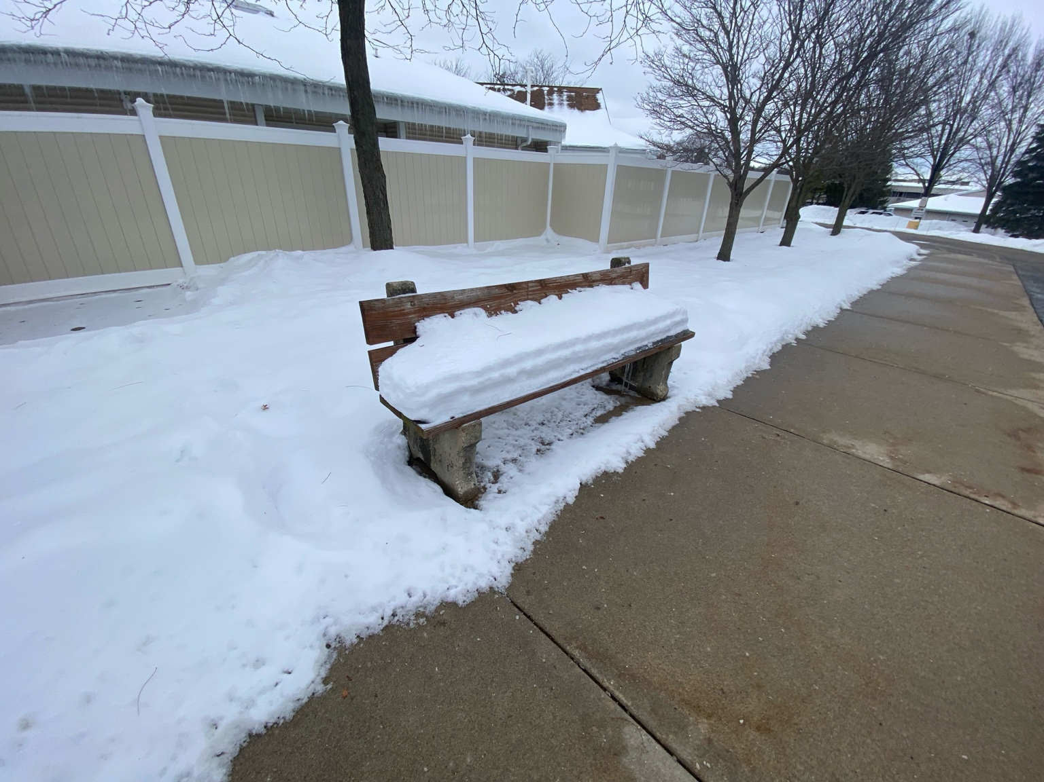
Public seating disappears under accumulating snowfall.

Slide 11
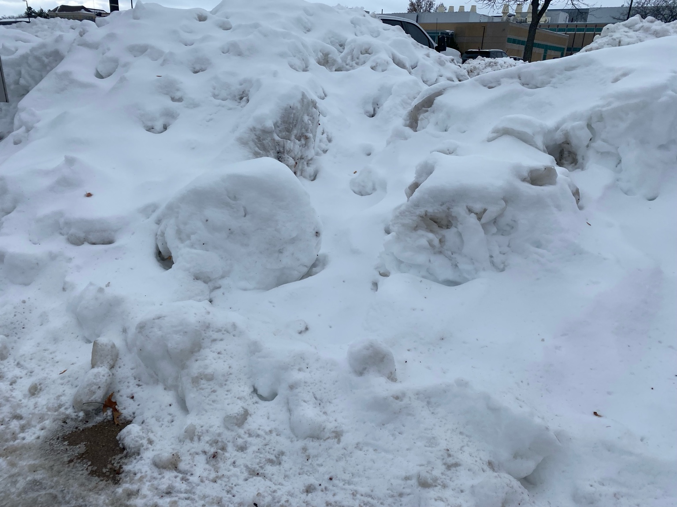
Snow removal pushes hazards to roadside edges.

Slide 12
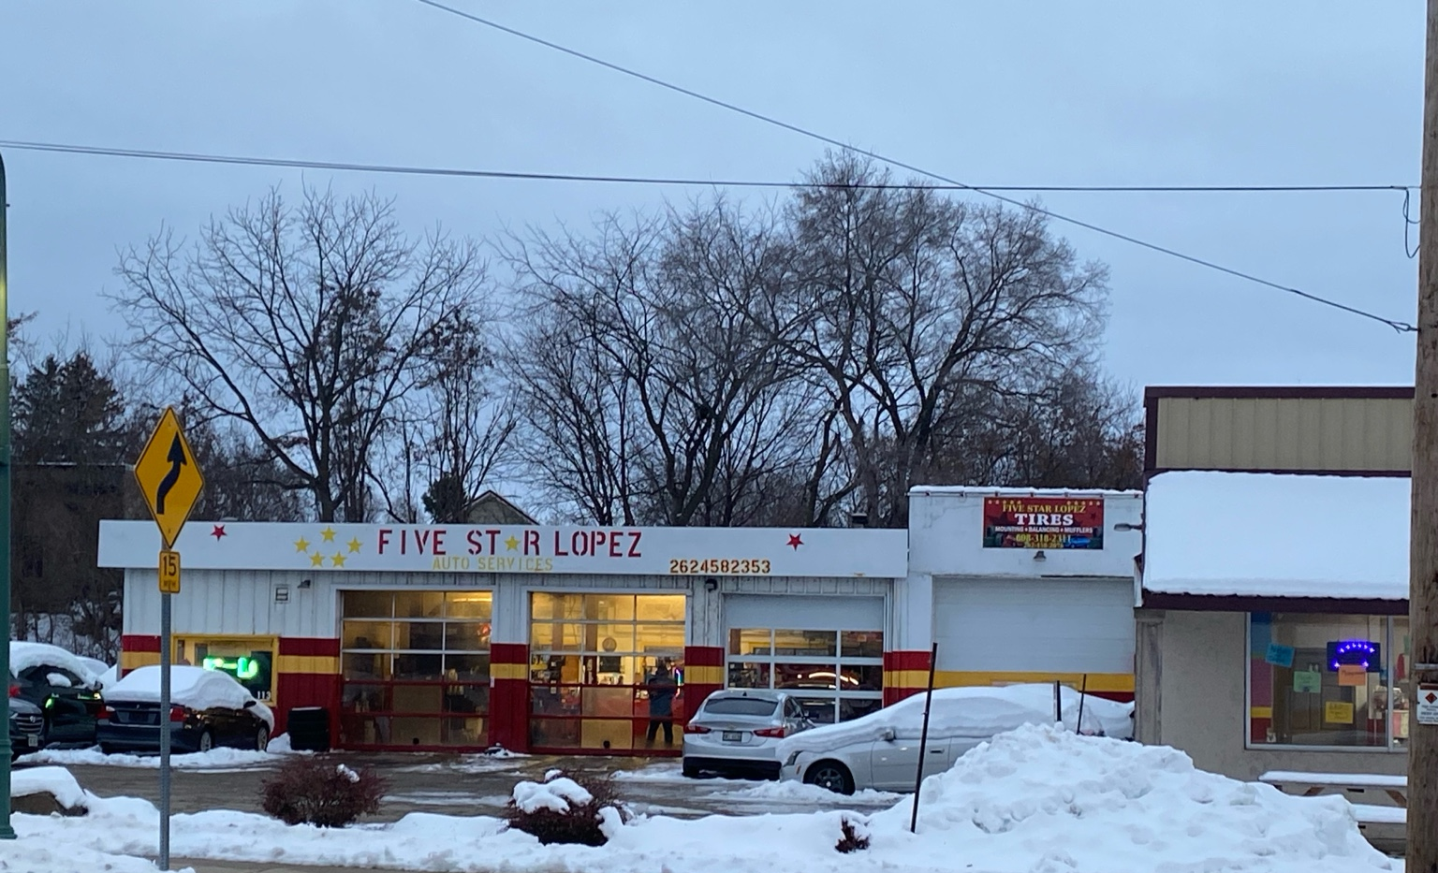
Local repair shops see increased winter-related vehicle damage.

Slide 13
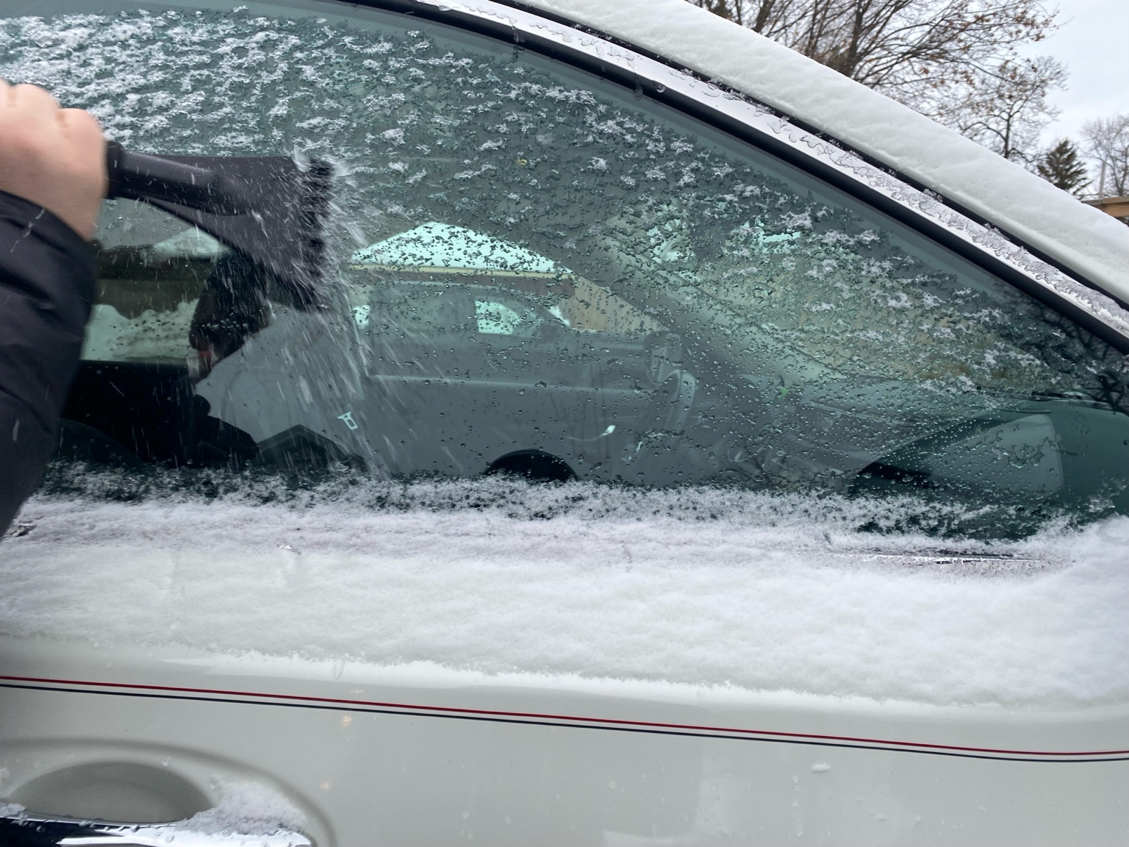
Daily ice removal adds time and maintenance to winter driving.

