Slide 1
Learning and Social Class on Campus UW - Whitewater
Will Barratt, Ph.D.

Slide 2
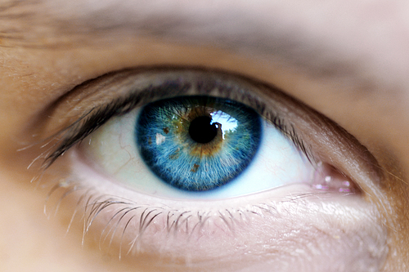
You see what you want to see
Where is social class?
What is social class?
How do you assign social class?

Slide 3
What social class do you associate with:
Martinis
Blue – Upper classes
White – Middle classes
Red – Lower classes

Slide 4
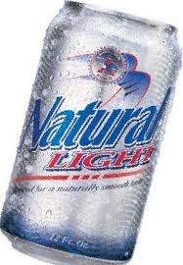
What social class do you associate with:
Natural Light
Blue – Upper classes
White – Middle classes
Red – Lower classes

Slide 5
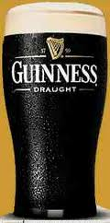
What social class do you associate with:
Guinness
Blue – Upper classes
White – Middle classes
Red – Lower classes

Slide 6
What social class do you associate with clothing brands?
Nike
Prada
Armani
Red Wing

Slide 7
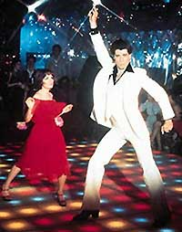
What about fabrics?
Polyester
Silk

Slide 8
What about retail stores?
Wal-Mart
Lands End
Nordstrom

Slide 9
Vacation destinations?
At home vacations
Florida vacations
European vacations

Slide 10
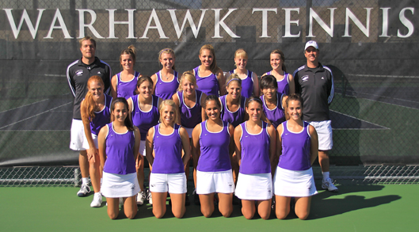
What about sports?
NASCAR
Polo
Golf
Tennis

Slide 11
What about a college / university?
Ivy League / Seven Sisters
UW - Whitewater

Slide 12
Building social class vocabulary
Everything begins with language

Slide 13
Social class is economic
It is about economies and collective individual economic actions

Slide 14
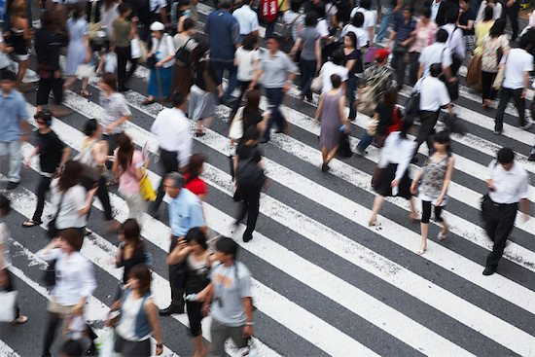
Social class is sociological
It is about societies and collective individual social actions

Slide 15
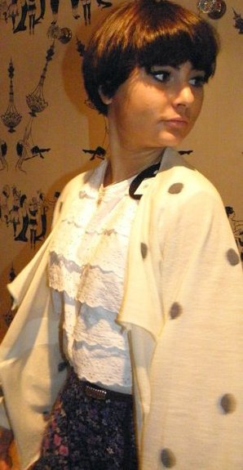
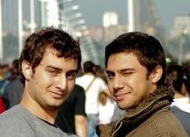
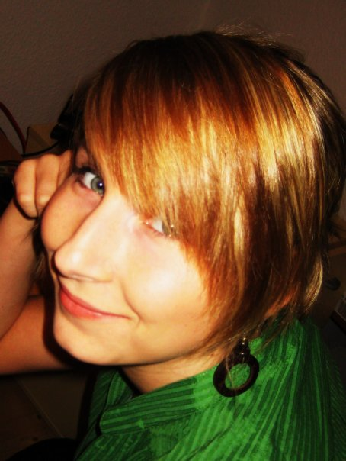
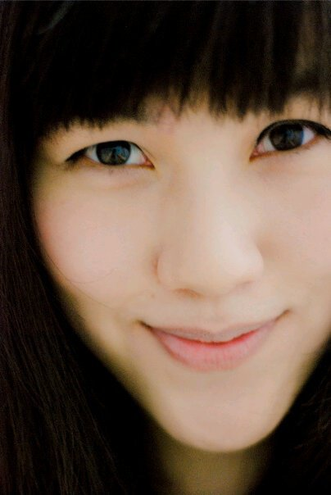
Social class is personal
It is about you and it is about me

Slide 16
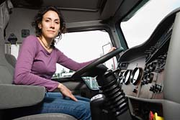
Social class is income and wealth
Income is potential wealth
Wealth is having more than you owe
Are a truck driver with an $80,000 income and her nurse husband with a $50,000 income in the upper-middle class?
Is a professor with a $50,000 income in the middle-middle class?

Slide 17
Social class is prestige
People talk as though class is money.
People act as though class is prestige.

Slide 18
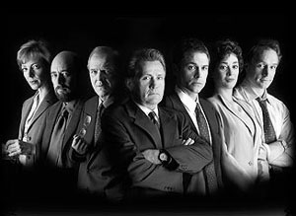
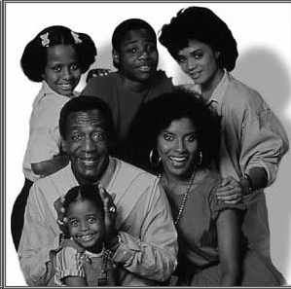
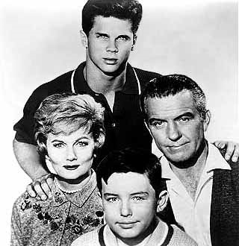
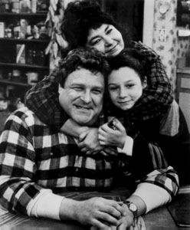
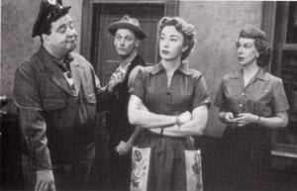
Class is a collection of subcultures arranged in a hierarchy of prestige

Slide 19
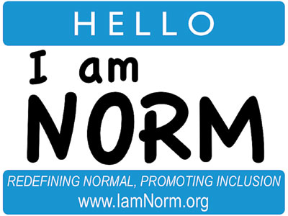
Cultural norms
Norms about fashion, food, and fun
Norms about education
Norms about money
Norms about work

Slide 20
Social class is an identity
Social class of origin
Where we came from
Current felt social class
What we think of our selves today
Attributed social class
What others think of us today

Slide 21
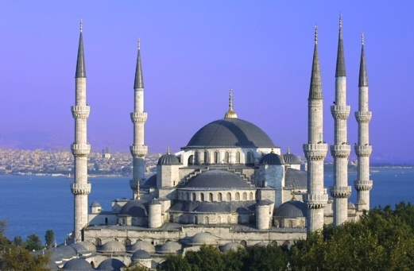
Social class is capital
Economic capital
Cultural capital
Social capital
Academic capital
Others?

Slide 22
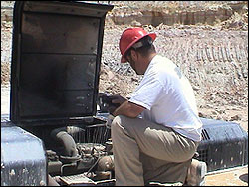
Social class is occupational prestige
Occupations are prestige ranked based on our collective beliefs.

Slide 23
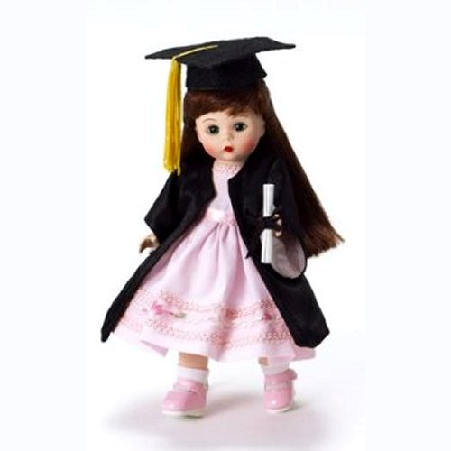
Social class is educational attainment
Income and occupational prestige are related to educational attainment.
Does getting a degree automatically change who you are?

Slide 24
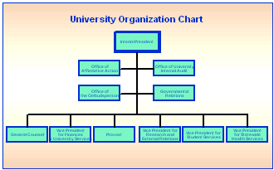
Social class is a system of structures and relationships
Campus organizational structures
Student organizations
Formal and informal relationships with faculty

Slide 25
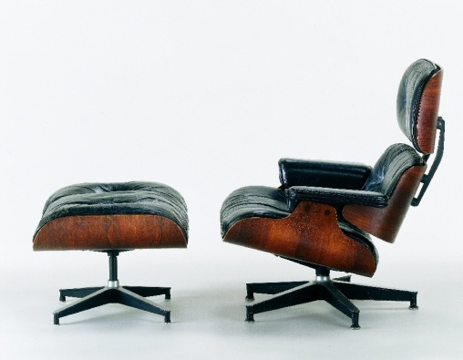
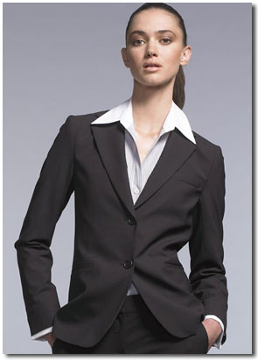
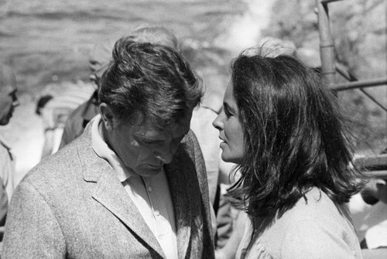
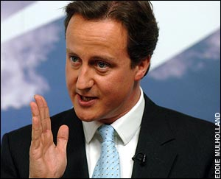
Social class is an enacted role
Props
Costumes
Blocking
Scripts

Slide 26
The reproduction of social class
Class based norms are reinforced on campus by faculty, students, administrators, and staff.
Who is the “good student”?
Economic capital
Cultural capital
Social capital
Academic capital

Slide 27
The reproduction of social class
College admissions creates barriers for students who went to economically poor schools.
Should we penalize people for being poor by putting them in poor quality public schools, telling them they won’t succeed, and creating barriers to higher education?

Slide 28
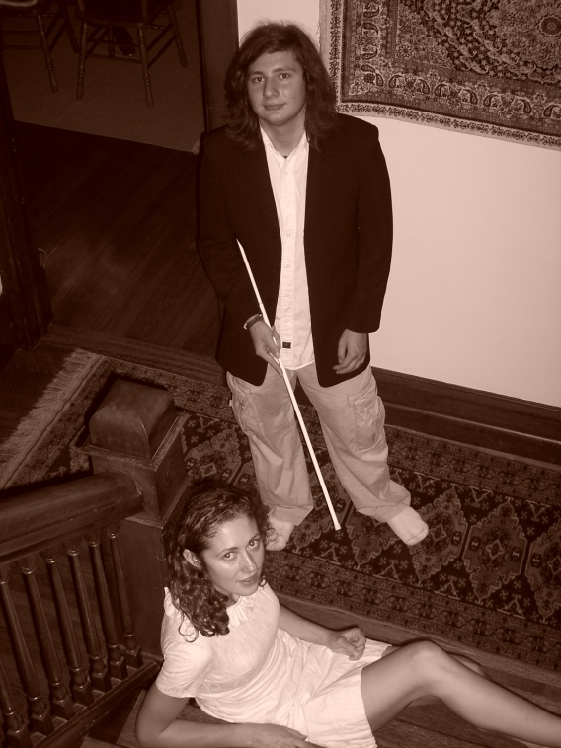
Social class contrast
Campus norms reflect the majority class culture, usually upper-middle class.
Anyone not native to that culture, above or below, will experience class contrast.
Poor campus-student fit will result in students leaving

Slide 29
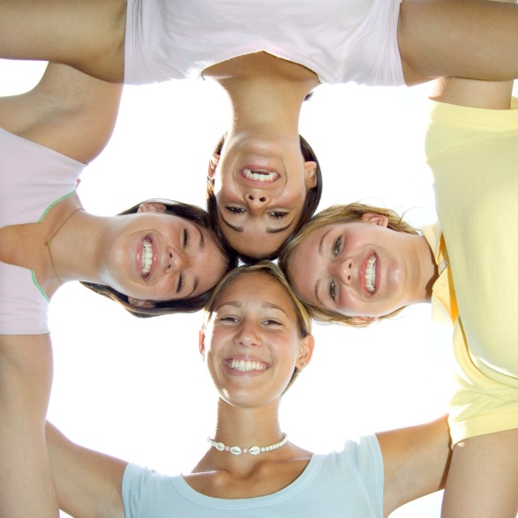
Campus is not a level playing field
The best predictor of college success is family income.
High school student leaders become college student leaders.
Some people were born on 3rd base and think they hit a triple.
(Attributed to B. Switzer)

Slide 30
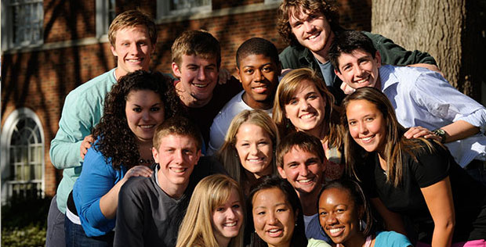
What about people?
We have ideas about social class and stuff, but what about social class and people?

Slide 31
Your class story
As we move through this experience think about your social class history.
What was your house like growing up?
How much support did or could your parents give you with your education?
Is your current felt social class the same as your social class of origin?
Later tonight, write it down.
Tomorrow, reflect on it.

Slide 32
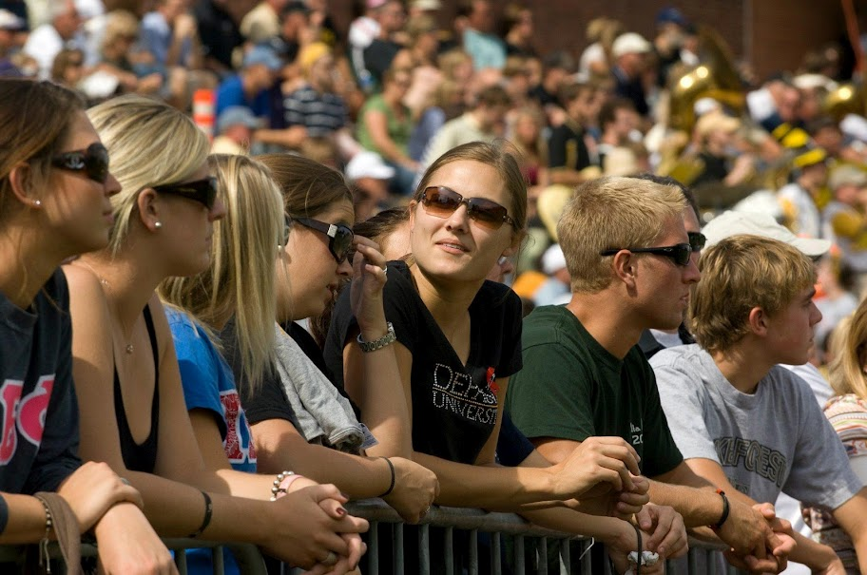
About Misty and Markey
What is the majority social class student like on this campus?
What do their parents do?
What brands does she wear, or does he wear?
What is their attitude toward college?
Are they entitled or do they ask permission to do things?

Slide 33
About Misty and Markey
What is the majority social class student like on this campus?
What do they bring to campus?
Stuff
Experiences
Where might they experience class contrast on campus?

Slide 34
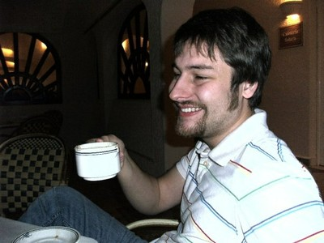
About Louise and Larry
What is the first generation student like on this campus?
What do their parents do?
What brands does she wear, or does he wear?
What is their attitude toward college?
Are they entitled or do they ask permission to do things?

Slide 35
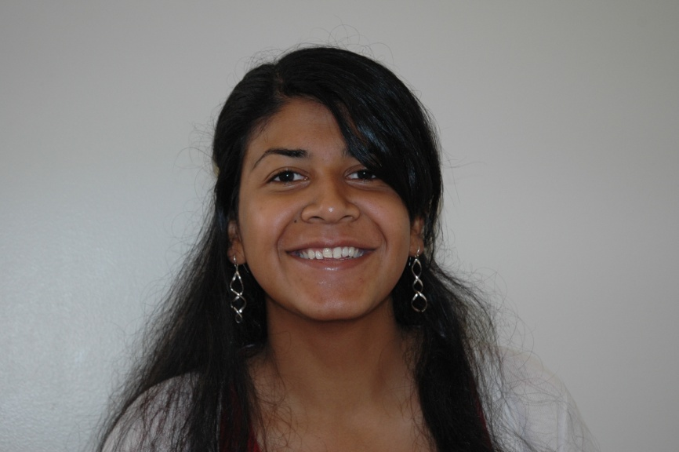
About Louise and Larry
What is the first generation student like on this campus?
What do they bring to campus?
Stuff
Experiences
Where might they experience class contrast on campus?

Slide 36
Different backgrounds
Educational background?
Experience background?

Slide 37
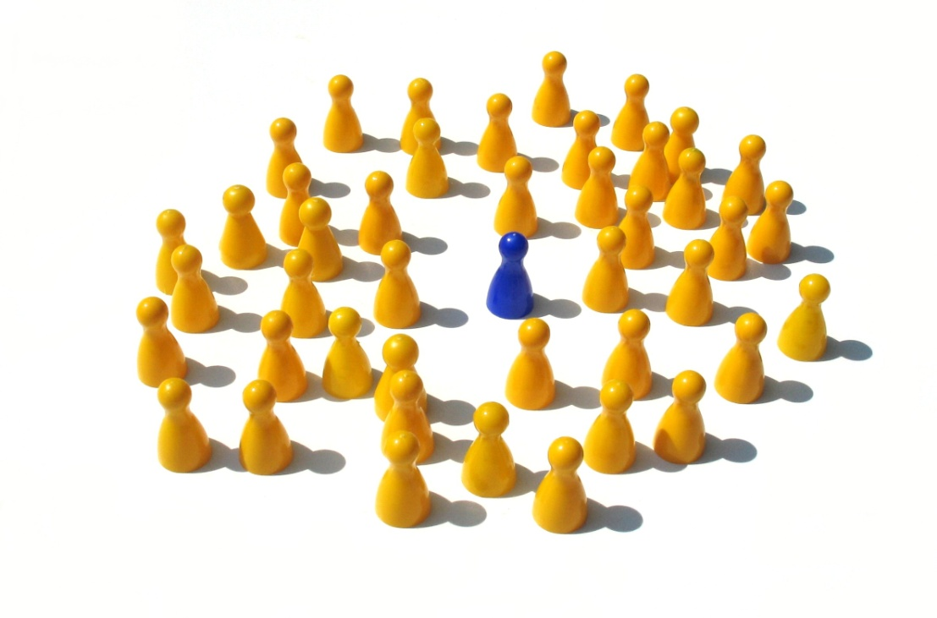
Different support
Resources for extracurricular activities?
Parental support and encouragement?

Slide 38
Different campus experiences
How do we advantage one or the other?
How do we disadvantage one or the other?

Slide 39
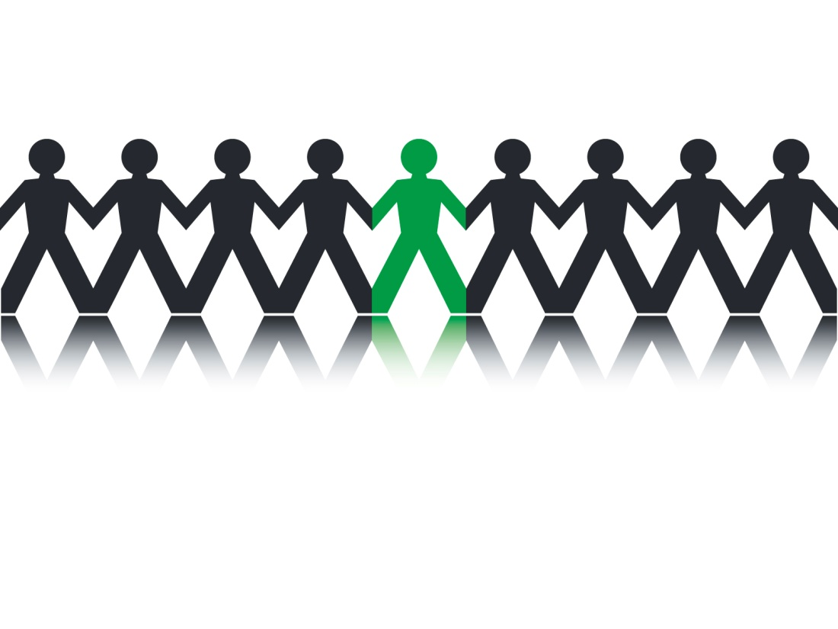
Differences in learning
What assumptions do we have about what Misty and Markey and Louise and Larry know when they come to campus?

Slide 40
Differences in learning
How might these students learn differently?
How might these students have different attitudes toward learning?

Slide 41
Louise and Larry
What is it like on this campus when you are not in the majority class group?
Relationships with faculty?
Relationships with students?
Do students try to ‘class pass’?

Slide 42
Misty and Markey
What is it like on this campus when you are in the majority class group?
Relationships with faculty?
Relationships with students?
Do students try to ‘class pass’?

Slide 43
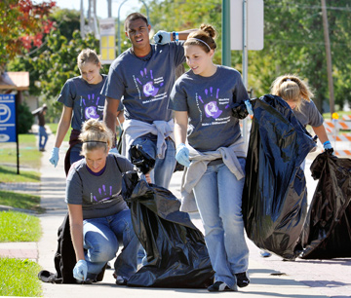
Question
How do you begin a caring, considerate, and developmental conversation about class with a majority class student?

Slide 44
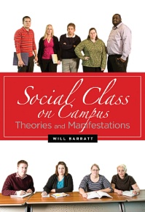
Thanks
Will Barratt, Ph.D.
will.barratt@indstate.edu
http://socialclassoncampus.blogspot.com/

